Slide 1
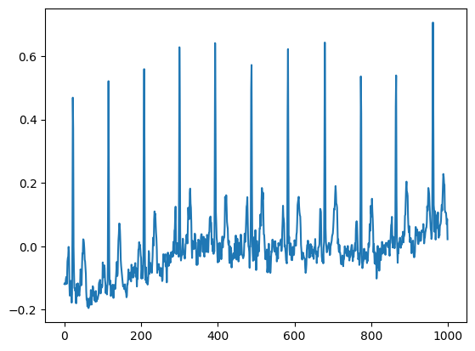
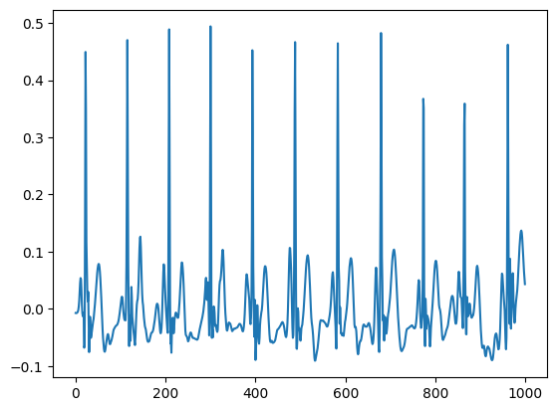
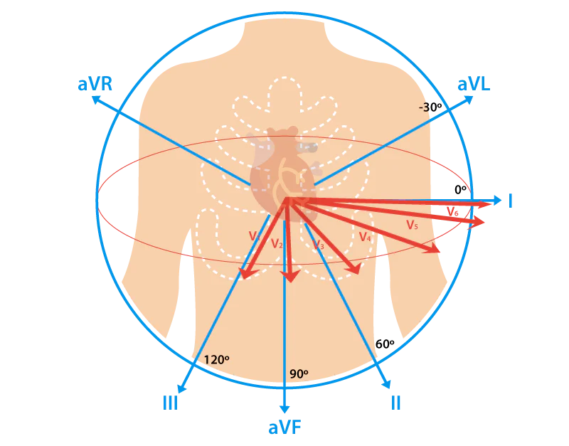
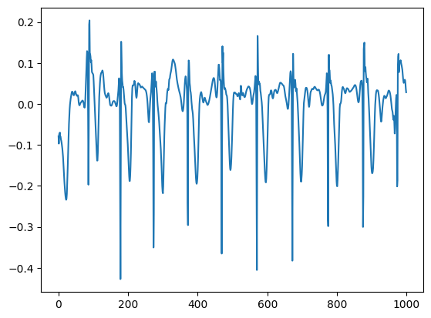
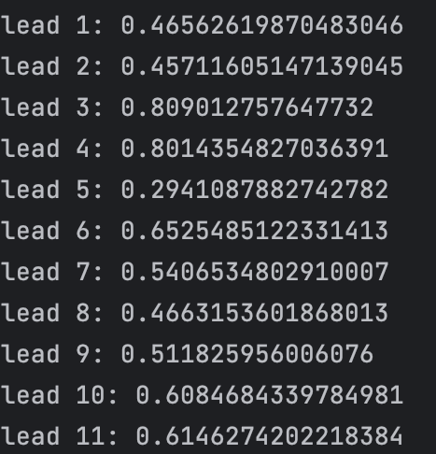
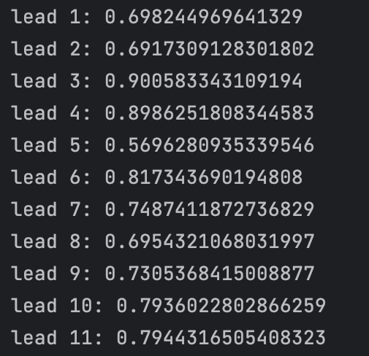
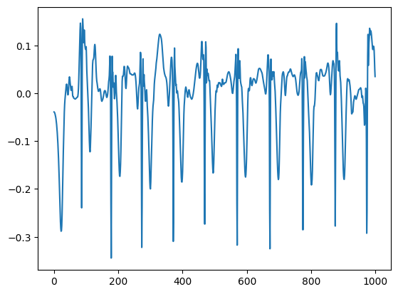
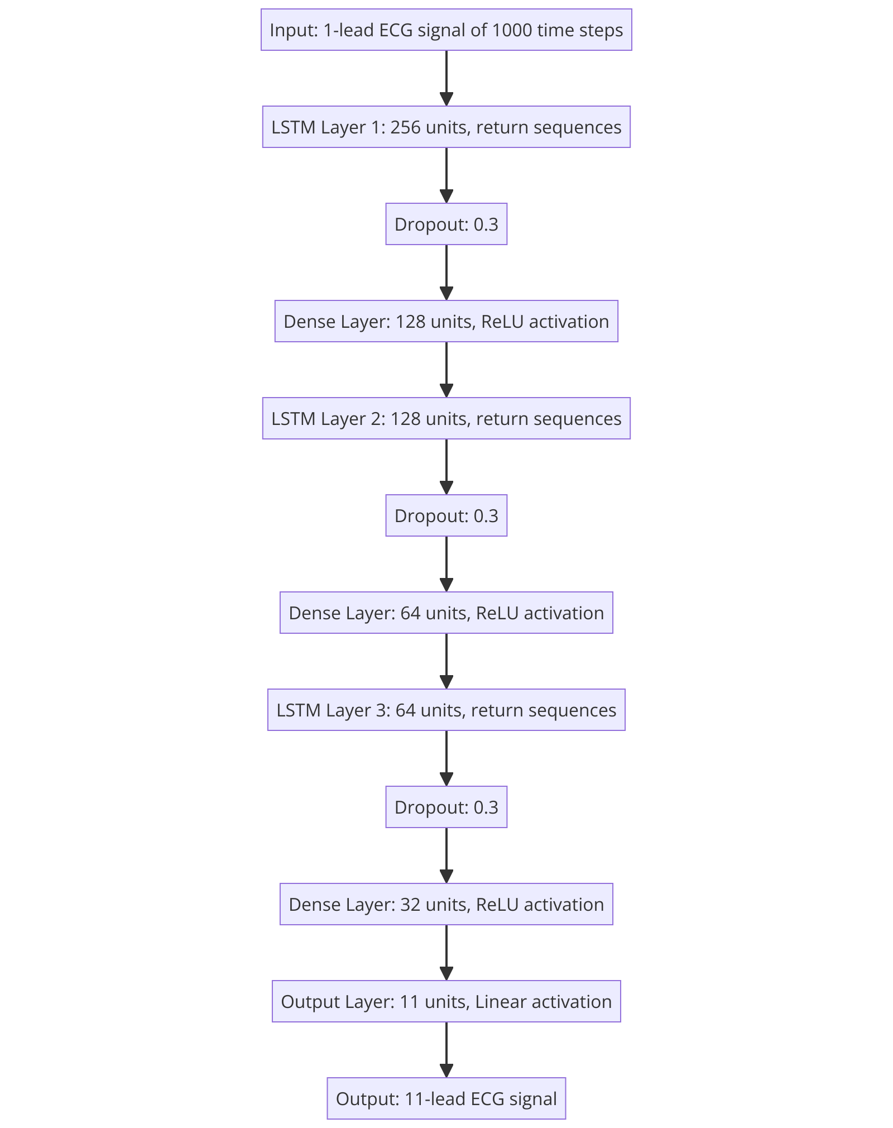
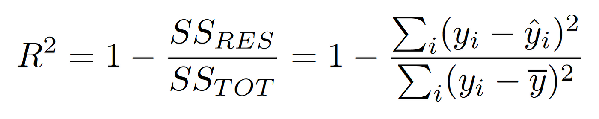
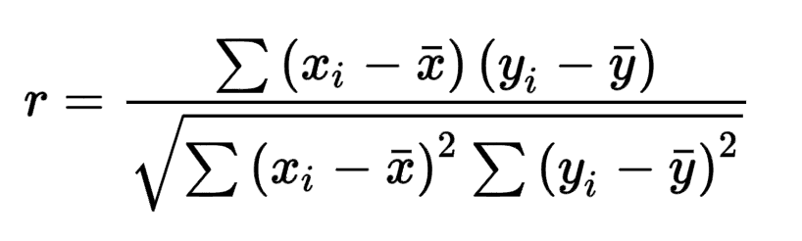
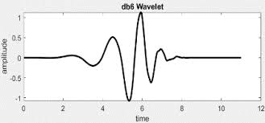
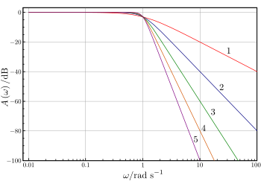
Single Lead To 12 Lead ECG Conversion using LSTM Neural Networks
Sravanth Chowdary Potluri, Jathin Nadella, Chandulal
Work Done For The Project of the Course Bio Signal Processing And Analysis At IIITDM Kancheepuram under Dr. Rohini P
Introduction
Results
Electrocardiography (ECG) is a crucial diagnostic tool for cardiovascular diseases, providing comprehensive insights into the heart's electrical activity. However, in many remote or emergency settings, the availability of comprehensive ECG data is often limited to just a single lead, which significantly hampers diagnostic capabilities. This project aims to address this challenge by leveraging deep learning techniques, specifically Long Short-Term Memory (LSTM) models, to generate a complete 12-lead ECG from a single-lead input (Lead I). By enhancing ECG monitoring and diagnostic accuracy from minimal data, this approach has the potential to significantly improve patient care in diverse and resource-constrained environments.
Shown in the image is the Pearson correlation coefficient and R2 Scores for the remaining 11 leads for our best performing model
R2 Scores of the models:
Without Noise Removal : 0.42
Simple Model With Noise Removal : 0.53
Medium Sized Model With Noise Removal : 0.54
Large Model With Noise Removal : 0.56
Noisy Signal
Denoised Signal
Model Training : Experimented with multiple single input LSTM Models with and without noise removal and evaluated the model using evaluation metrics such as Pearson correlation coefficient and r2 score. Ran the models for 100 epoch with an early stopping of patience 5 and a loss function of Mean Squared Error
Shown in the image is the best performing model according to our evaluation metrics with peak correlation coefficient of 0.9 in lead 4 and 5 and an r2 score of 0.56
Metrics Used :
R² Score: It measures how well a regression model predicts the actual values, with 0 indicating no predictive power and 1 indicating perfect prediction.
Pearson Correlation: It quantifies the strength and direction of a linear relationship between two variables, ranging from -1 (perfect negative correlation) to +1 (perfect positive correlation).
Actual And Reconstructed Signals Top and Bottom Respectively
Project Objective
R2 Scores
PCC
Use LSTM models to generate the complete set of 12-lead ECG data from the data captured from a single lead (Lead I).
Conclusion
Experimented in training the PTB-XL dataset with models of various sizes with and without noise removal and achieved promising results for the regeneration of the ECG signal from a single lead
The achieved results are still a bit away from the SOTA results considering the current literature works on 3 lead ECG set for regeneration while we used single lead information for the regeneration.
This suggests a need for more robust models which have better temporal and spatial handling capacities such as ConvLSTM and LMU (Legendre Memory Unit) or models with different features such as convolution and larger number of layers with skip connections
Methodology
Dataset Used : The PTB-XL dataset is a large, publicly available collection of over 20,000 clinical 12-lead ECG records, each 10 seconds long. It includes detailed metadata such as patient demographics and clinical diagnoses, making it a valuable resource for developing and testing machine learning models in cardiac diagnostics.
Noise Removal : Used Butterworth filter and discrete wavelet transform using db-6 wavelet to remove the low frequency(baseline wander) and high frequency noise in the signal
R2 Score
References
Lee, Hong J., et al. "Reconstruction of 12-lead ECG Using a Single-patch Device." Methods of Information in Medicine 56.04 (2017): 319-327.
Sohn, Jangjay, et al. "Reconstruction of 12-lead electrocardiogram from a three-lead patch-type device using a LSTM network." Sensors 20.11 (2020): 3278.
I. Tomašić and R. Trobec, "Electrocardiographic Systems With Reduced Numbers of Leads—Synthesis of the 12-Lead ECG," in IEEE Reviews in Biomedical Engineering, vol. 7, pp. 126-142, 2014, doi: 10.1109/RBME.2013.2264282.
Zhu, F., Ye, F., Fu, Y. et al. Electrocardiogram generation with a bidirectional LSTM-CNN generative adversarial network. Sci Rep 9, 6734 (2019). https://doi.org/10.1038/s41598-019-42516-z
A. Kapfo, S. Datta, S. Dandapat and P. K. Bora, "LSTM based Synthesis of 12-lead ECG Signal from a Reduced Lead Set," 2022 IEEE International Conference on Signal Processing, Informatics, Communication and Energy Systems (SPICES), THIRUVANANTHAPURAM, India, 2022, pp. 296-301, doi: 10.1109/SPICES52834.2022.9774204. Used 3 Leads
Zacarias, Henriques, et al. "ECG Forecasting System Based on Long Short-Term Memory." Bioengineering 11.1 (2024): 89
Pearson Correlation Coefficient
DB-6 Wavelet
Butterworth Filter

